Slide 1
CSI4999 - Project 6
Rec Center Management
Sprint 5 Presentation
By: Eapen James, Noah Giles, Aaron Goodfellow, Tyler Streu, Taylor Piot, Doris Gjata, Eric Myllyoja

Slide 2
Sprint 5’s User Stories We focused on
As a user, I can see equipment associated with a room
As a user, I can view pages available at the Rec Center
As an administrator, I can view reservations made by users
As an administrator, I can create equipment bundles for room setup
As an administrator, I can view equipment reservations
Notes:
Eapen

Slide 3
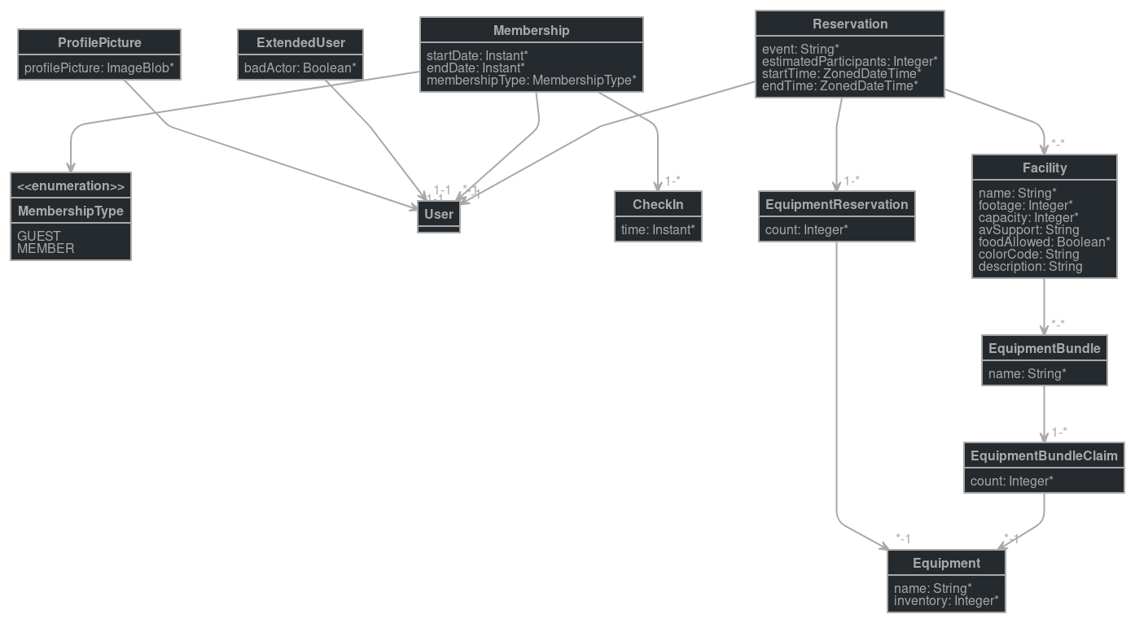
Entity Diagram
New development on REST endpoints and business logic, including:
Diving into JHipster’s filtering API to improve fetch efficiency
Revising some underlying JPA configurations to more aggressively deal with derivative items
Some entities would probably be in strongly determined relationships sans Jhipster
Cleaning up serialization and making POST / PUT controllers more friendly
Notes:
Noah

Slide 4
QA Testing
Users can view new pages
All reservations accessible by admins
Users cannot create overlapping reservations, or reservations in the past or far future.
Admins can view all room and equipment reservation pages
Functionality of Calendar improvements
Admins can view inventory of available equipment
Notes:
Eric

Slide 5
Risks and Challenges
Busy time of year
Illness, job interviews, and exams makes it harder to get together to iron out kinks
Integration between components
As our project gets more complicated, it gets harder to avoid side-effects
Front-end back-end integrations
Hibernate eager-fetching data
Notes:
Doris

Slide 6
DEMO
Notes:
Aaron

Slide 7
Next Sprint Objectives
Stories:
As a user, I can reserve equipment
As a user, I can view previously made / pending reservations
As a user, I can select custom equipment for a reservation
As an admin, I can view/modify/accept/deny reservations
Notes:
Tyler

